Slide 1

Privacy-Aware federated learning
Mohammad Farhan & Md Tamjid Hossain
CS 791: Project
Notes:
https://www.analyticsinsight.net/neural-networks-not-answer-everything/

Slide 2
Outlines
Background
Introduction
Motivation
Research Problem Overview
Literature reviews and research gap
Summary
Research objectives
Major Contributions
Core Methodology
Threat modelling
Algorithm design
Experimental Analysis
Setup & Simulation
Evaluation
Discussion
Conclusion
Summary
Future works
Q&A

Slide 3
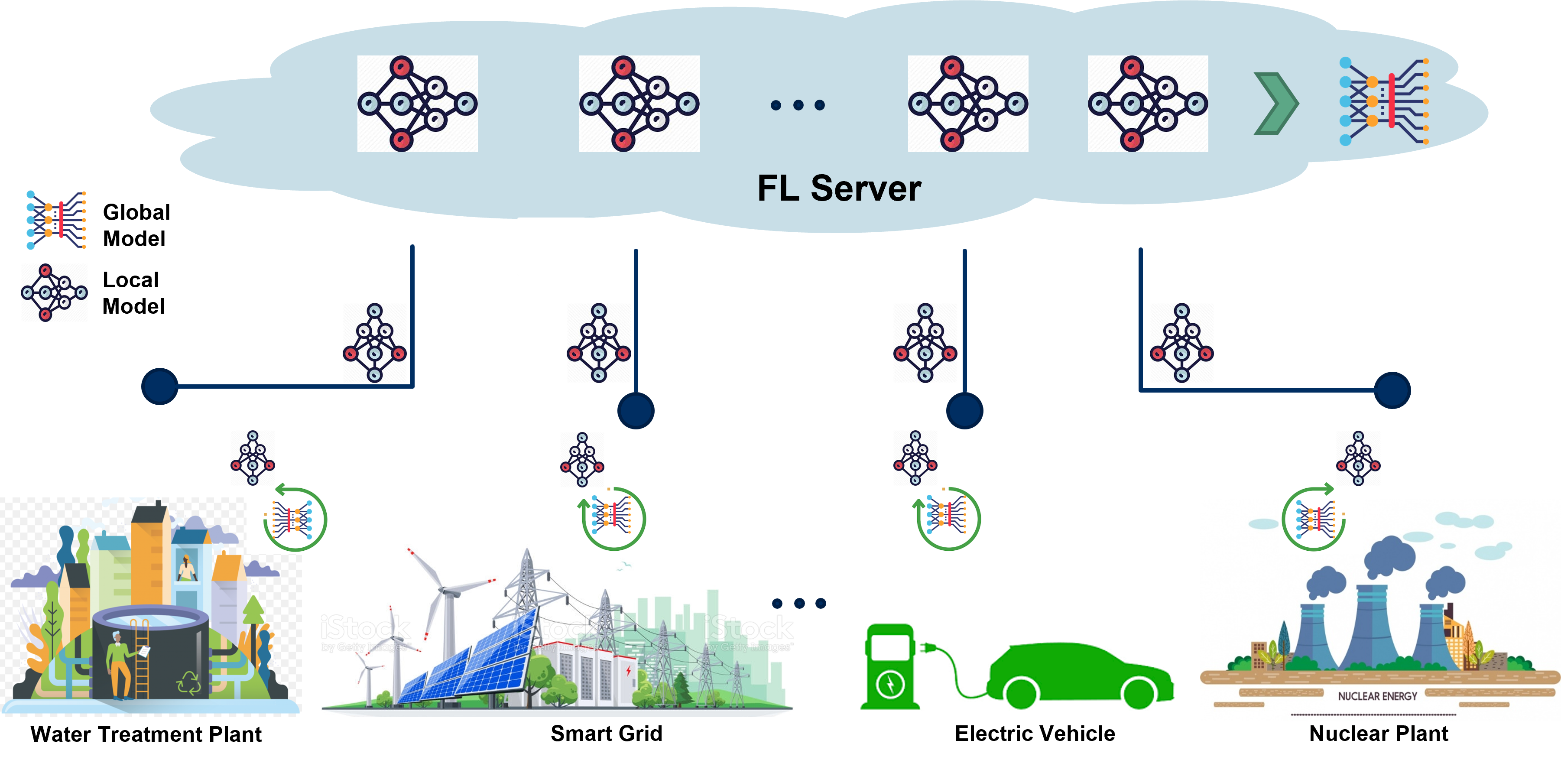
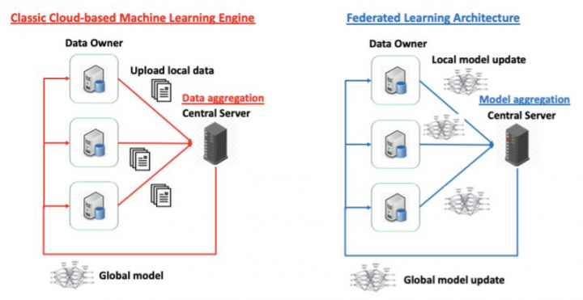


Background Introduction: Federated Learning
Federated Learning (FL)
Brendan McMahan et al. (2017)
Model is trained locally
Local nodes share Data Model parameters
Central server aggregates the trained local models to form global model
Until targeted accuracy achieved, process continues

Slide 4

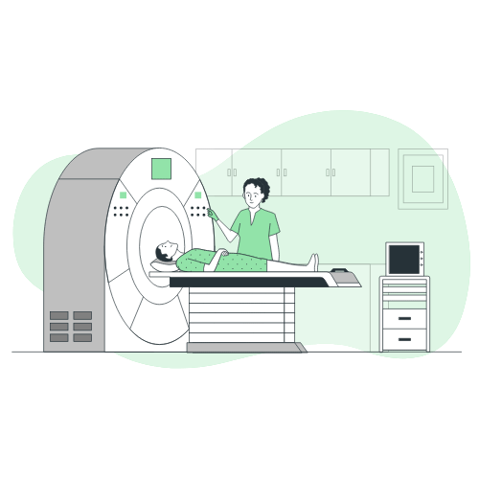

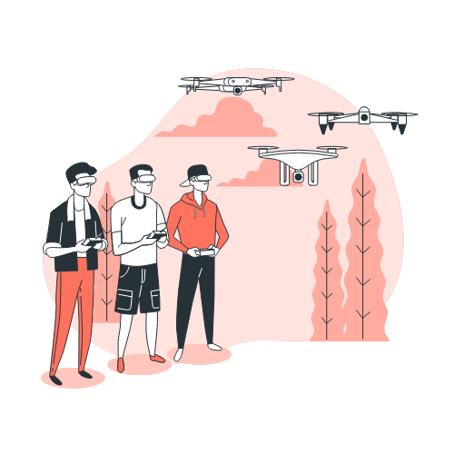


Background Introduction: FL Applications
Smart Healthcare
Robotic Control
Industrial Process Automation
Automated Transportation
UAV Control
Cyber-physical Energy Systems
Notes:
https://storyset.com/

Slide 5
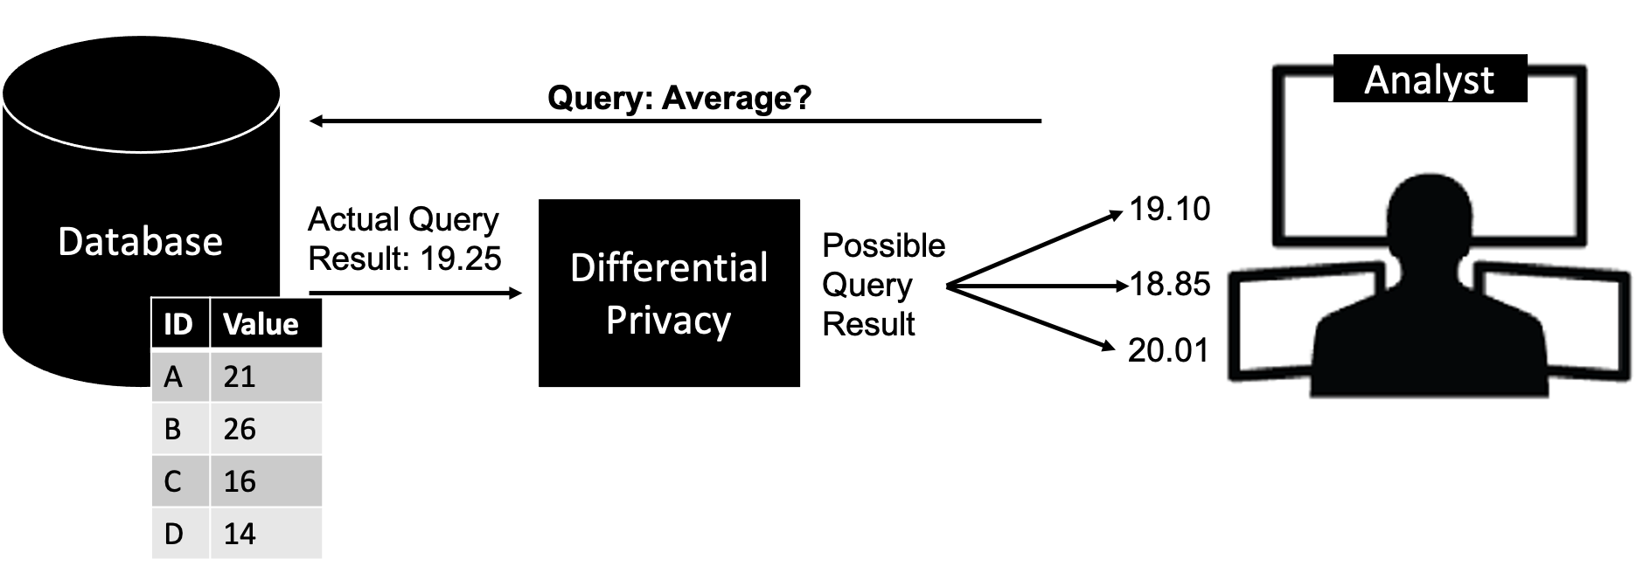






Background Introduction: Differential Privacy
Differential Privacy (DP)
Randomized noise addition mechanism that follows some statistical distributions and privacy conditions to anonymize a single contribution
+ Many more

Slide 6
Background Motivations
Why Federated Learning (FL)?
Why Differential Privacy (DP)?
Inherent privacy protection
Provides high-assurance to data privacy
Major Benefit
Major Benefit
Already adopted by numerous companies
Already adopted by numerous companies
Practical Method
Practical Method
Targeted/Untargeted data/model poisoning attack
Wide-scale adversarial analysis of DP is yet to be performed
Research Opportunity
Research Opportunities

Slide 7


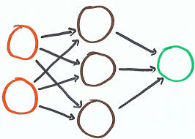
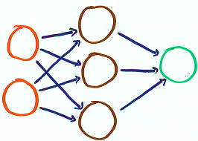
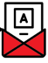
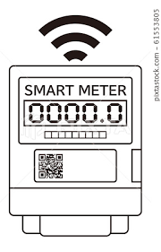
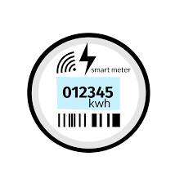




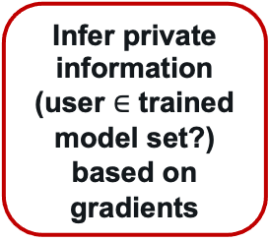
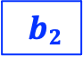



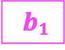


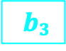
Research Problem Overview
Federated Learning
Remote Aggregator
Membership Inference Attack in Federated Learning
Model formulation and calculation
Infer private information (user $∈$ trained model set?) based on gradients
Adversary
$$W$$
$$b$$
Global Model
Aggregated/Updated gradients
Local Devices
$$w1$$
$$b1$$
$$w2$$
$$b2$$
$$w3$$
$$b3$$
$$wn$$
$$bn$$
Notes:
https://storyset.com/

Slide 8
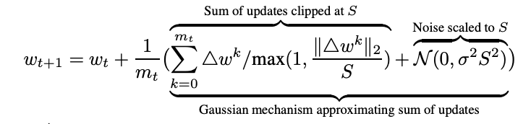
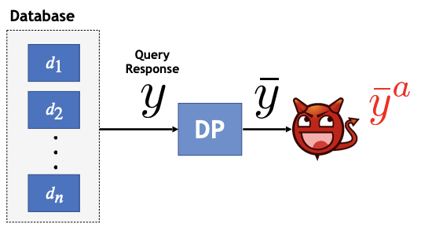
Research Problem Overview Literature Review
Advances and Open Problems in Federated Learning (McMahan et al., 2021)
Preserving the privacy of user data
SMPC, TEC, HE, DP
Differentially private federated learning: A client level perspective (Geyer et al., 2017)
DP-FL, moments accountant, global differential privacy, MNIST
Adversarial classification under differential privacy (Giraldo et al., 2020)
DP-exploitation
Injecting false data that is hard to distinguish from a measurement with DP-noise
Notes:
Differentially Private Asynchronous Federated Learning for Mobile Edge Computing in Urban Informatics (Lu et al., 2019)
DP-AFL, local differential privacy, vehicular network

Slide 9
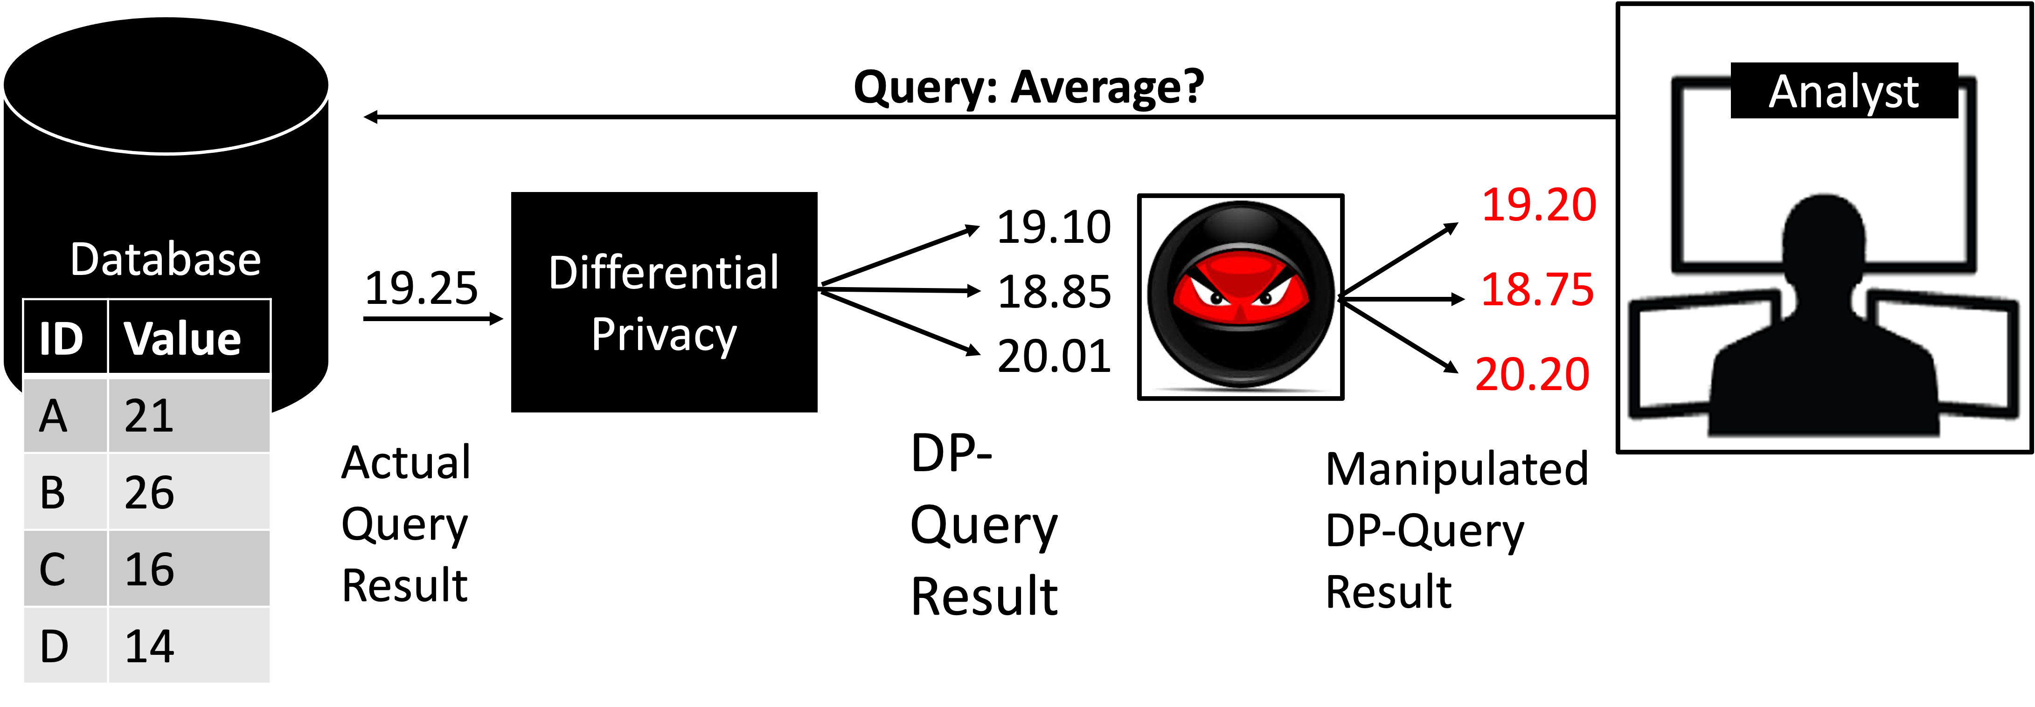
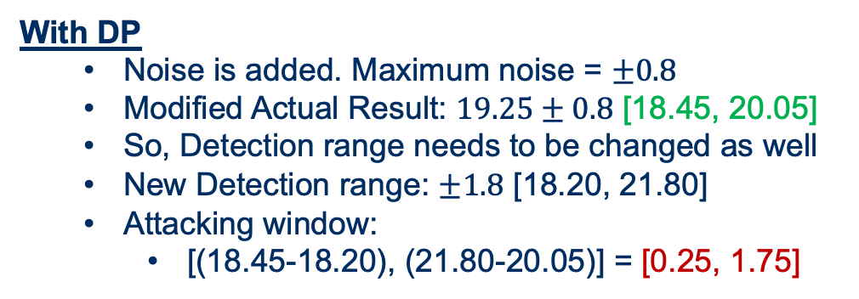
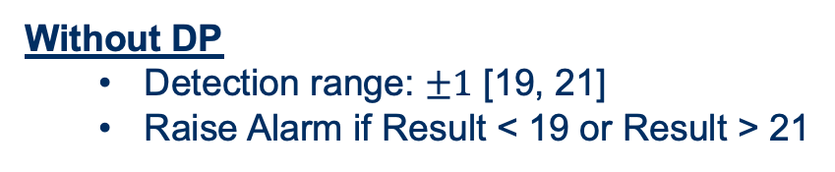
Research Problem Overview Numerical example
Expected Result : 20.00
Actual Result : 19.25
Without DP
Detection range: $±1$ [19, 21]
Raise Alarm if Result < 19 or Result > 21
With DP
Noise is added. Maximum noise = $±0.8$
Modified Actual Result: $19.25±0.8$ [18.45, 20.05]
So, Detection range needs to be changed as well
New Detection range: $±1.8$ [18.20, 21.80]
Attacking window:
[(18.45-18.20), (21.80-20.05)] = [0.25, 1.75]

Slide 10
Summary
[privacy measure] DP – popular and widely adopted data privacy preservation technique
[research area] FL – proposed to apply in the following applications in critical infrastructure domain:
Predictions (energy or resource consumption, traffic volume)
System fault, disturbance detection & correction
State estimations
Intelligent decision making
[research intersection] DP-FL
[problem overview] FL can be vulnerable to Membership Inference Attacks. DP is proposed to overcome this problem
[research gap] The impacts of Differential Privacy have not been analyzed rigorously in Federated Learning process
[research statement] This work analyzes the impact of the differential privacy in FL process

Slide 11
Major Contributions
Developing a DP-FL process based on LDP
Analyzing the impacts of DP-integration in terms of data utility
Exploring the exploitation opportunity (to conduct model poisoning attack) of DP in FL
Analyzing the computational cost of DP-integration in FL

Slide 12
Core Methodology Threat Model
Attacker’s Background Knowledge:
The attacker may have partial knowledge about the dataset and its distribution
Attacker’s Capability:
The attacker can manipulate model update regardless of the attack vector
The attacker cannot change the models that are already in the server
Attacker’s Objectives:
Degrade model performance (Attack impact)
Stay anonymous (Stealthiness)

Slide 13
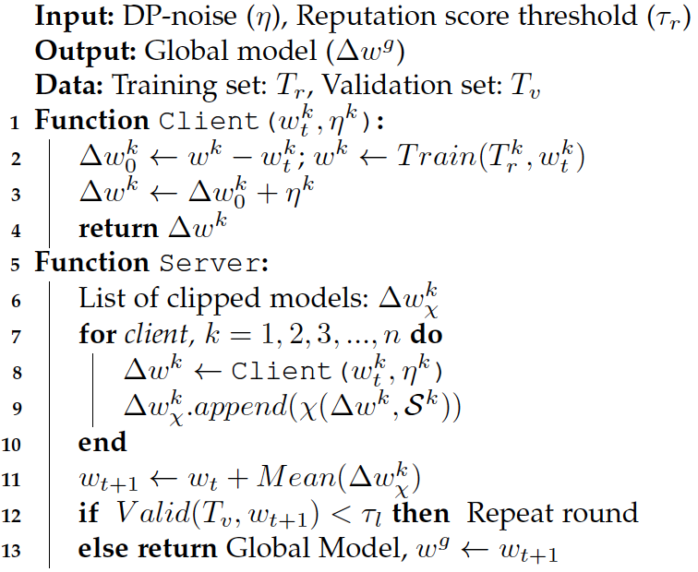

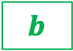
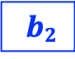




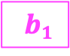

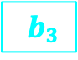
Core Methodology Algorithm Design: DPFL
Federated Learning
Remote Aggregator
$$W$$
$$b$$
Global Model
Local Devices
$$w1$$
$$b1$$
$$w2$$
$$b2$$
$$w3$$
$$b3$$
$$wn$$
$$bn$$

Slide 14
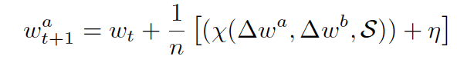
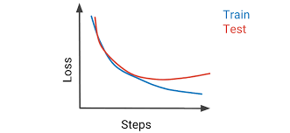
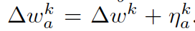
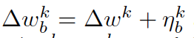
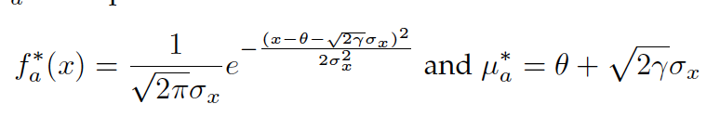
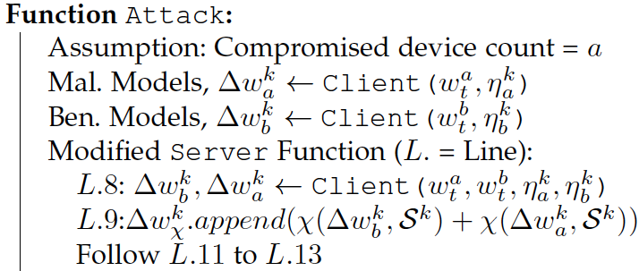
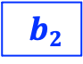


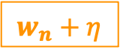
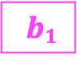

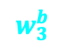
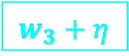

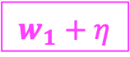
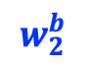
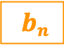

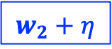
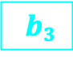



Core Methodology Algorithm Design: DP-Exploited Attack
$$w_{k}^{a}←w_{k}^{b}+η_{a}$$
Federated Learning
Remote Aggregator
$$w_{k}^{a}$$
$$w_{k}^{a}$$
$$w_{k}^{b}$$
Adversary
$$W$$
$$b$$
Global Model
Local Devices
$$w_{1}+η$$
$$b1$$
$$w_{2}+η$$
$$b2$$
$$w_{3}+η$$
$$b3$$
$$w_{n}+η$$
$$bn$$
$$w_{3}^{b}$$
$$w_{n}^{b}$$
$$w_{1}^{b}$$
$$w_{2}^{b}$$

Slide 15
Experimental Analysis Setup & Simulation
Dataset:
Individual Household Electric Power Consumption (Hebrail et al., 2012)
Measurement: 2,075,259
Range: Dec 2006-Nov 2010
(∼47 months)
Programming Language: Python
Module: PyTorch
Type: Linear Regression
Batch Size: 32
Epoch: 50
Activation function: ReLU
Performance Metric: MSE
GD Optimizer: Adamax
Learning Rate: 0.001
Variant: Mini batch GD

Slide 16
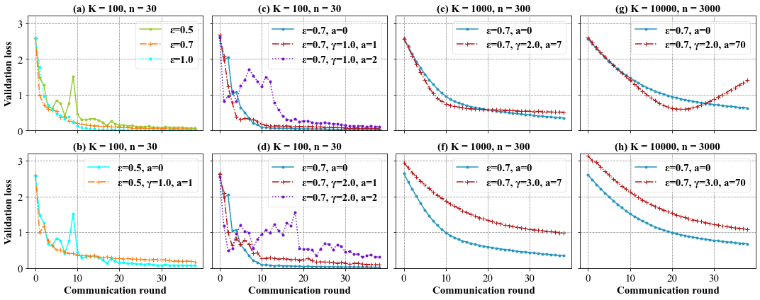
Experimental Analysis Evaluation
Impact: Privacy increases – Attack impact increases – Model performance degrades
Tradeoff: [Privacy] – [Security] – [Utility]

Slide 17
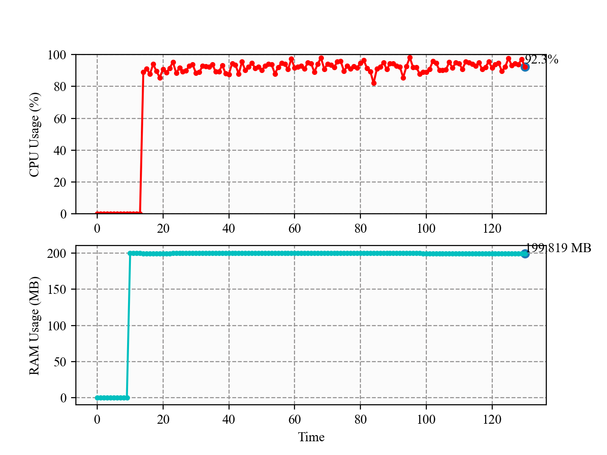
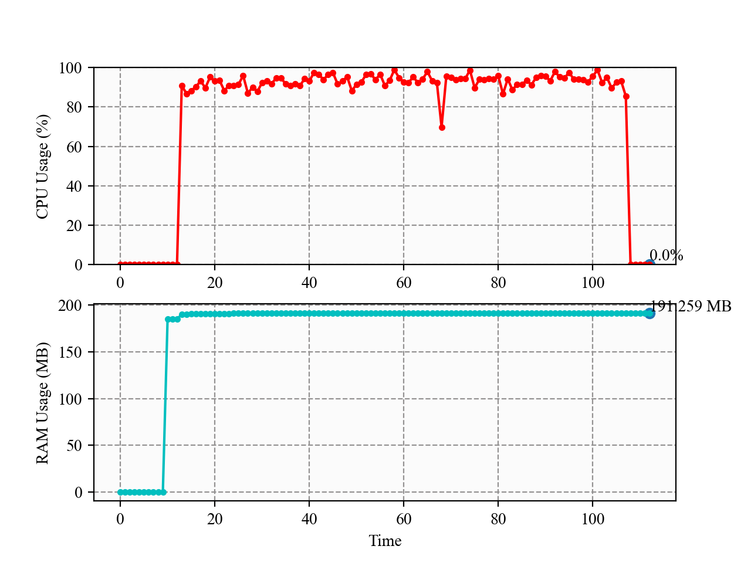
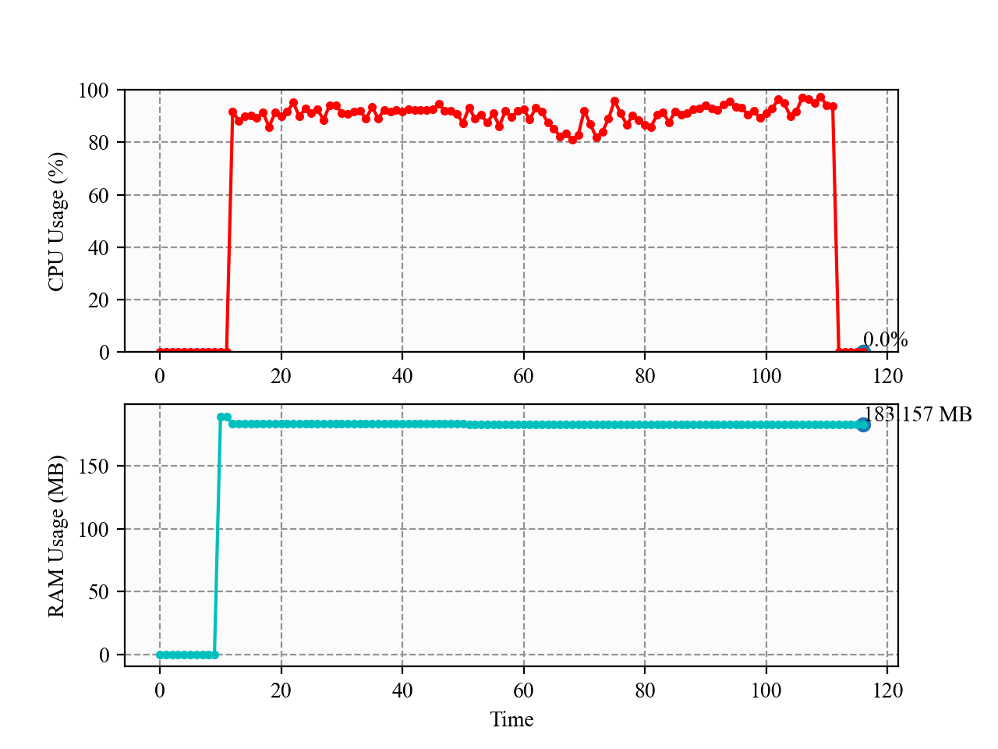
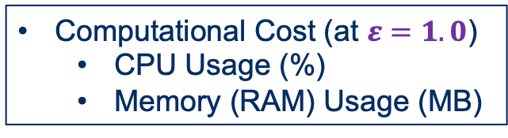
Experimental Analysis Evaluation
No significant change in computational cost in terms of CPU and Memory usage
So, side channel analysis through CPU and RAM usage is difficult
Therefore, DP-exploited attack is stealthy
Computational Cost (at $ε=1.0$)
CPU Usage (%)
Memory (RAM) Usage (MB)
Case-II: DP-exploited Attack implemented
Case-I: No Privacy
Case-II: DP implemented

Slide 18

Conclusion & Future Works
We develop a privacy-preserved federated learning technique to collaboratively train energy consumption prediction model
Our evaluation shows that the DP can be exploited to conduct poisoning attacks in FL
We hope to extend this work for better model accuracy and loss.
Also, the developing the defense mechanisms against such attacks would be another interesting avenue to explore.
GitHub Link of the project code: https://github.com/TamjidHossain/CS791_DPFL_Project

Slide 19

Q&A

